Slide 1
More about the market-basket model

Slide 2
Overview of video
Here, we will see:
more complex tables (i.e. with respect to a column instead of the full table)
association rules
a-priori algorithm

Slide 3
More Complex Tables
Sometimes data is more complex:
Items are clear (milk, bread, cookies, juice, eggs, …), but what are the baskets?
Solution: consider baskets with respect to a column
Exercise sheet for next week will make this more clear
Purchase ID | Customer ID | Items bought
101 | A | milk, bread, cookies, juice
792 | B | milk, juice
1130 | A | milk, bread, eggs
1735 | C | bread, cookies, coffee

Slide 4
Example 1 (1/4): Customer Baskets
Baskets with respect to customer IDs:
One basket per customer ID
Basket for customer ID cid: all items that appear under “Items bought” in rows that have customer ID cid
Example: basket for ‘A’: {milk, bread, cookies, juice, eggs}
Purchase ID | Customer ID | Items bought
101 | A | milk, bread, cookies, juice
792 | B | milk, juice
1130 | A | milk, bread, eggs
1735 | C | bread, cookies, coffee

Slide 5
Example 1 (2/4): Customer Baskets
Equivalently: restrict to customer IDs & items bought
Then combine baskets for customer IDs:
Purchase ID | Customer ID | Items bought
101 | A | milk, bread, cookies, juice
792 | B | milk, juice
1130 | A | milk, bread, eggs
1735 | C | bread, cookies, coffee
Customer ID | Items bought
A | milk, bread, cookies, juice, eggs
B | milk, juice
C | bread, cookies, coffee

Slide 6
Example 1 (3/4): Customer Baskets
Define all other notions using new baskets / table:
Support of a set J with respect to the customers: support of J computed using the new set of baskets
J is frequent with respect to the customers: if its support with respect to the customers is at least the support threshold
Customer ID | Items bought
A | milk, bread, cookies, juice, eggs
B | milk, juice
C | bread, cookies, coffee

Slide 7
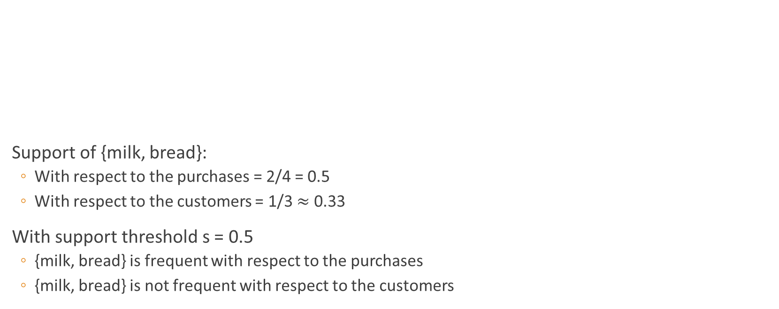
Example 1 (4/4)
Purchase ID | Customer ID | Items bought
101 | A | milk, bread, cookies, juice
792 | B | milk, juice
1130 | A | milk, bread, eggs
1735 | C | bread, cookies, coffee
Support of {milk, bread}:
With respect to the purchases = 2/4 = 0.5
With respect to the customers = 1/3 $≈$ 0.33
With support threshold s = 0.5
{milk, bread} is frequent with respect to the purchases
{milk, bread} is not frequent with respect to the customers

Slide 8
Example 2
Transaction ID | Customer ID | Items bought
101 | A | X, Y, Z
792 | B | W, X
1130 | A | W, Z
1735 | C | X
What is the support for {W, X} with respect to transactions?
What is the support for {W, X} with respect to customers?
1/4
Note: support with respect to a column (like customers here) can be bigger (like here) or smaller (like in the previous example) than the support with respect to the full table
2/3

Slide 9
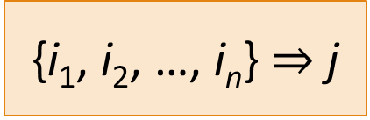
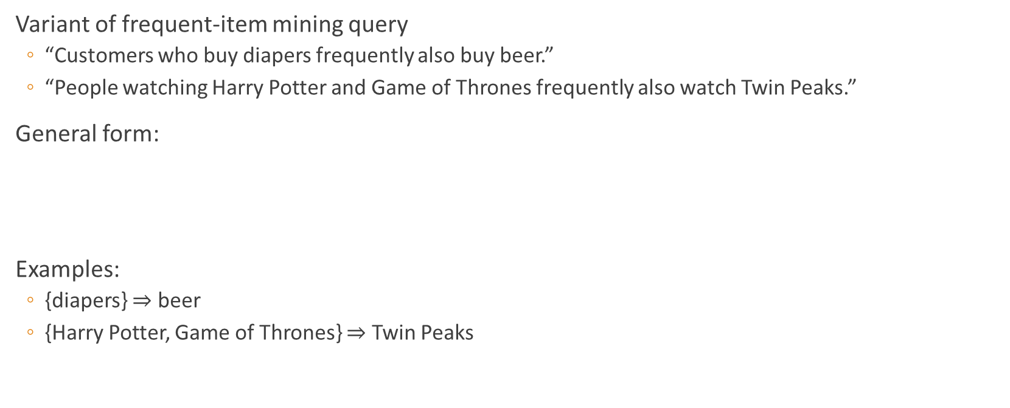
Association Rules
Variant of frequent-item mining query
“Customers who buy diapers frequently also buy beer.”
“People watching Harry Potter and Game of Thrones frequently also watch Twin Peaks.”
General form:
Examples:
{diapers} $⇒$ beer
{Harry Potter, Game of Thrones} $⇒$ Twin Peaks
{i₁, i₂, …, i_{n}} $⇒$ j
items

Slide 10
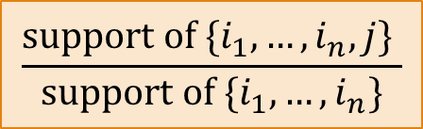
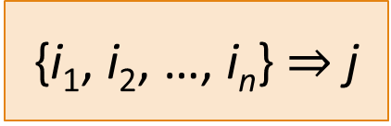
Association Rules: Properties
{i₁, i₂, …, i_{n}} $⇒$ j
Support: support of {i₁, i₂, …, i_{n}, j}
Want high support (not much benefit in exploiting the rule otherwise)
Confidence: percentage of baskets for {i₁, i₂, …, i_{n}} containing j
Should be high
”67% of all customers who bought milk also bought juice.”
Should differ significantly from fraction of baskets containing j
$$\frac{\text{support} \text{of} {\{i}_{1}, …, i_{n},j\} }{\text{support} \text{of} {\{i}_{1},…,i_{n}\}}$$

Slide 11
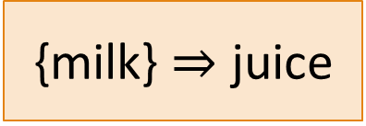
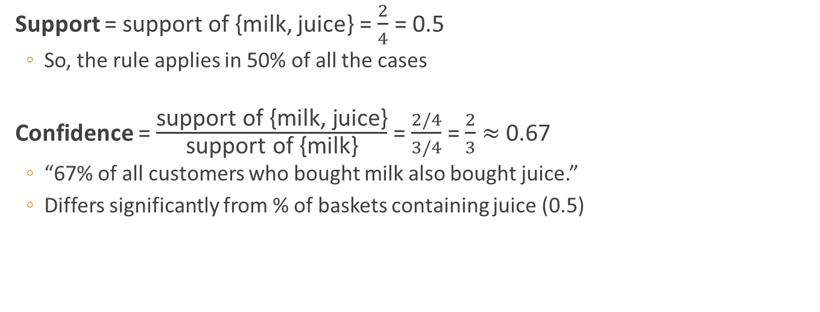
Example 1
{milk} $⇒$ juice
Purchase ID | Items bought
101 | milk, bread, cookies, juice
792 | milk, juice
1130 | milk, bread, eggs
1735 | bread, cookies, coffee
Support = support of {milk, juice} = $\frac{2}{4}$ = 0.5
So, the rule applies in 50% of all the cases
Confidence = $\frac{\text{support} \text{of}\text{ \{}\text{milk}\text{, }\text{juice}\text{\}}}{\text{support} \text{of}\text{ \{}\text{milk}\text{\}}}$ = $\frac{2/4}{3/4}$ = $\frac{2}{3}$ $≈$ 0.67
“67% of all customers who bought milk also bought juice.”
Differs significantly from % of baskets containing juice (0.5)

Slide 12
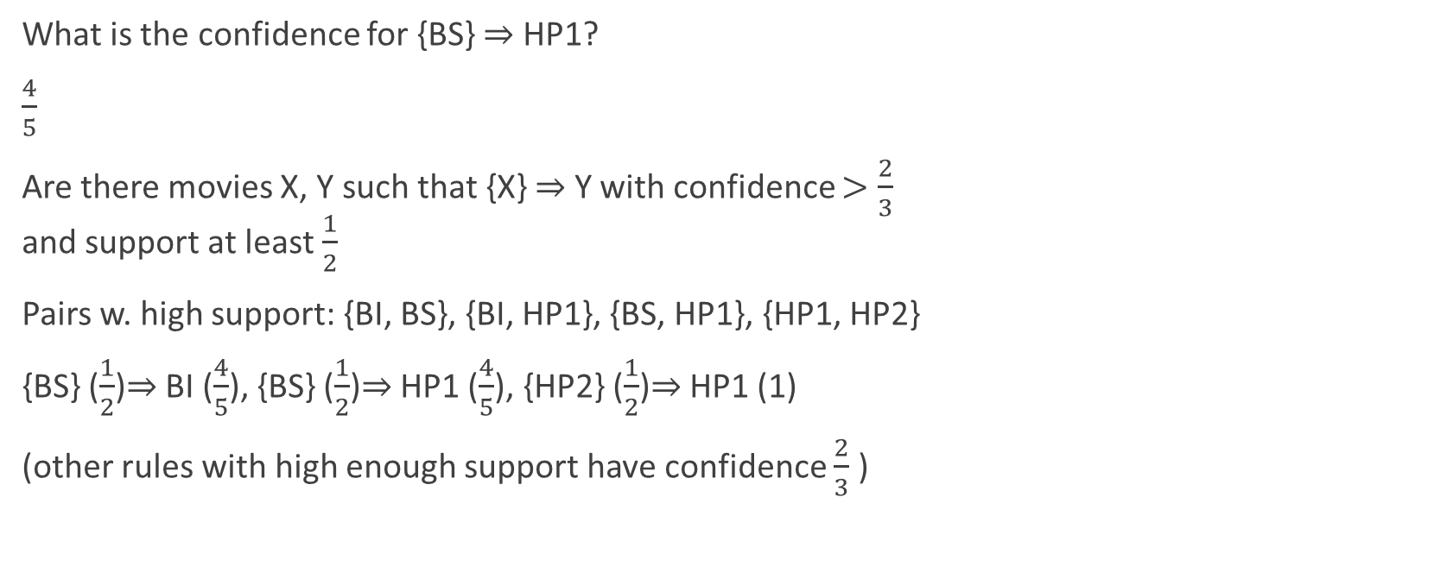
Example 2
What is the confidence for {BS} $⇒$ HP1?
$\frac{4}{5}$
Are there movies X, Y such that {X} $⇒$ Y with confidence $>\frac{2}{3}$ and support at least $\frac{1}{2}$
Pairs w. high support: {BI, BS}, {BI, HP1}, {BS, HP1}, {HP1, HP2}
{BS} ($\frac{1}{2}$)$⇒$ BI ($\frac{4}{5}$), {BS} ($\frac{1}{2}$)$⇒$ HP1 ($\frac{4}{5}$), {HP2} ($\frac{1}{2}$)$⇒$ HP1 (1)
(other rules with high enough support have confidence $\frac{2}{3}$ )
Viewer | Liked videos
Anna | BI, BS, BU
Ben | HP1, HP2, HP3
Chloe | BI, HP1
Dave | BI, BS, HP1, HP2
Emma | BI, BS, BU, HP1
Fred | BI, BU
Gwen | BS, HP1, HP2
Henry | BI, BS, HP1, HP2, HP3

Slide 13
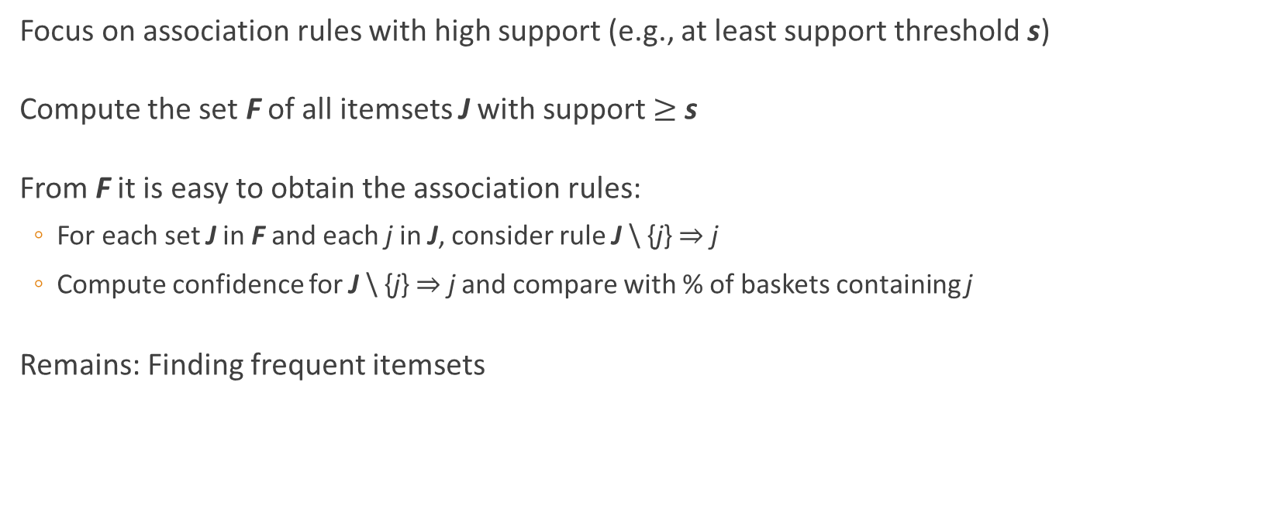
Finding Association Rules
Focus on association rules with high support (e.g., at least support threshold s)
Compute the set F of all itemsets J with support $≥$ s
From F it is easy to obtain the association rules:
For each set J in F and each j in J, consider rule J \ {j} $⇒$ j
Compute confidence for J \ {j} $⇒$ j and compare with % of baskets containing j
Remains: Finding frequent itemsets

Slide 14

A-Priori Algorithm
This was what I was using for that early example for finding the pairs of movies that had high support
Goal: compute all itemsets J with support $≥$ s
Crux:
Compute frequent item sets from smaller ones:
F₁ := item sets {i} with support $≥$ s
F₂ := item sets {i,j} with {i}, {j} $∈$ F₁ and support $≥$ s
F₃ := item sets {i,j,k} with {i,j},{i,k},{j,k} $∈$ F₂ and support $≥$ s
…
If J has support $≥$ s, then all subsets of J have support $≥$ s.

Slide 15
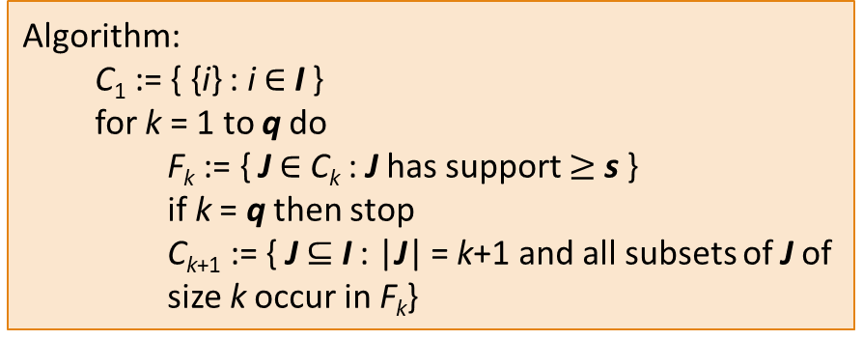

A-Priori Algorithm
Input: set of items I, set of baskets B, max. size q, support threshold s
Output: subsets J of I with |J| $≤$ q and support $≥$ s
Efficient implementation in SQL for fixed q (e.g., q=2)
Algorithm:
C₁ := { {i} : i $∈$ I }
for k = 1 to q do
F_{k} := { J $∈$ C_{k} : J has support $≥$ s }
if k = q then stop
C_{k+1} := { J $⊆$ I : |J| = k+1 and all subsets of J of size k occur in F_{k}}

Slide 16
Summary
We saw more complex tables (i.e. with respect to a column instead of the full table), association rules (i.e. does the presence of some items imply that more items are likely there too) as well as the a-priori algorithm (that was sketched in the first video as well)

